Slide 1
Mindfulness 101
Kayla Newkirk, M.S.

Slide 2
What to Expect:
What is Mindfulness?
Benefits of Mindfulness
Mindfulness Practices
Resources
Questions?
Notes:
Ask them a scaling question of how they are feeling 1-5 5 being the best and 1 being the worst. Or make a menti with words

Slide 3
Why Mindfulness Is a Superpower: An Animation
Notes:
https://www.youtube.com/watch?time_continue=89&v=w6T02g5hnT4&embeds_referring_euri=https%3A%2F%2Fhubblecontent.osi.office.net%2F&source_ve_path=Mjg2NjY&feature=emb_logo

Slide 4
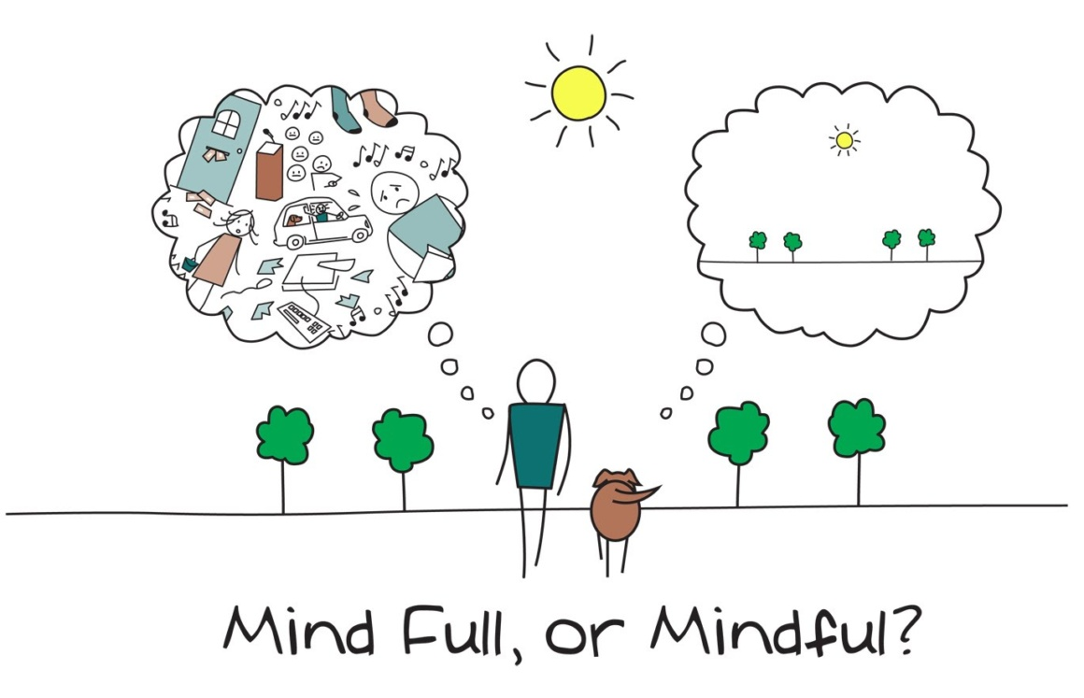
What is
mindfulness?
Mindfulness can be described as paying attention to what is happening in the mind, body and immediate surroundings.
Notes:
*remind them that mindfulness is not about perfection, but about taking each moment as an opportunity be present with yourself and what is around you.

Slide 5
Okay, what do I get from
being mindful?
Mindfulness can help us learn how to control our emotions and handle everyday stress better
One of the leading treatment for most mental health conditions (ie. PTSD, disordered eating, substance abuse)
Studies show that students who meditate before an exam perform better than students who do not
Mindfulness practice can improve concentration
Increase our immune system functioning
Mindfulness-based interventions have been demonstrated to reduce the symptoms of anxiety, stress and depression
Notes:
*add in info about test anxiety

Slide 6
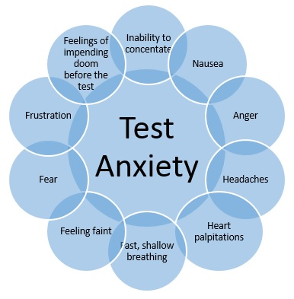

Slide 7
Benefits Beyond the Individual
How can practicing mindfulness benefit those around us and within the community?
Notes:
- More understanding amongst disagreements, more peaceful interactions and constructive interactions

Slide 8
How Mindfulness Empowers Us
Notes:
https://www.youtube.com/watch?v=vzKryaN44ss

Slide 9
Individual Experiences
Think of a time when being mindful might have changed the outcome. For example, misunderstandings that could have been avoided, or situations where reactions were impulsive.
Notes:
- (think, pair, share) 1-2 groups can share within the class . If nobody volunteers, we (each?) do an example

Slide 10
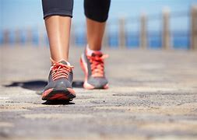
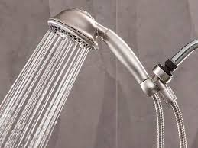
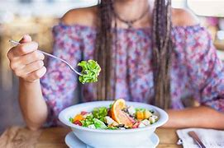
So, what does mindfulness look like?
When you think of activities that you can do mindfully, what comes to mind?
Notes:
Ask the class if they have any other examples. Ex: driving, etc. we can state as well

Slide 11
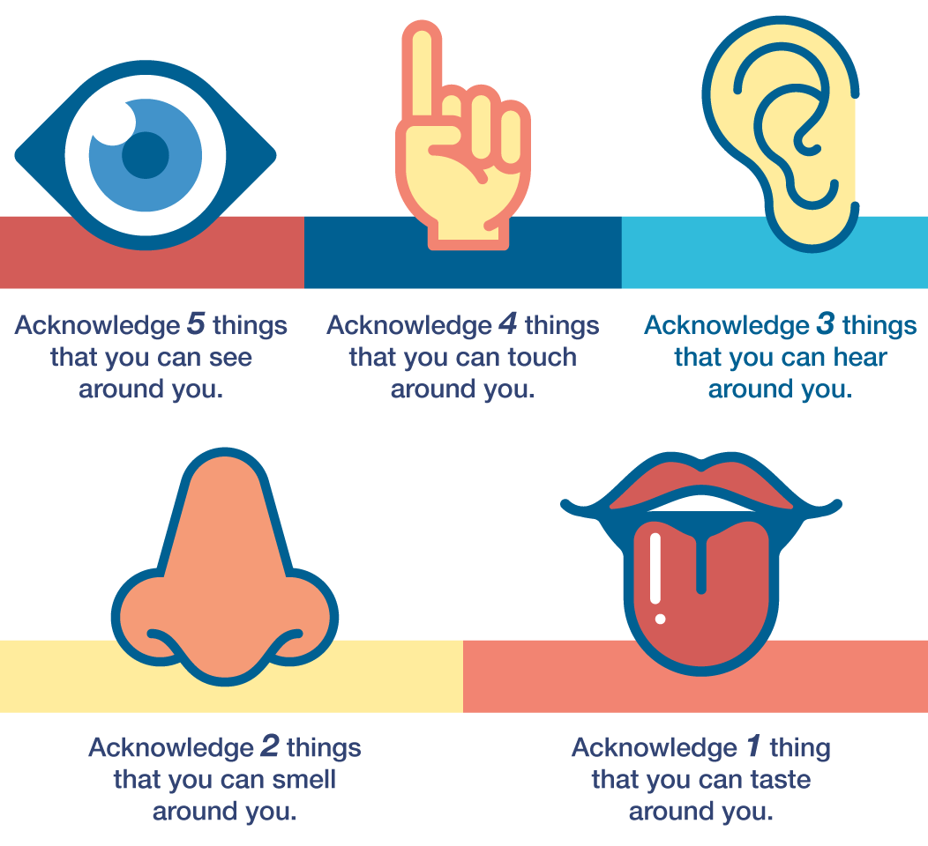
5-4-3-2-1 Grounding
Notes:
Scaling question – refer to beginning

Slide 12
Alright, let’s try it out!
Belly
Breathing

Slide 13
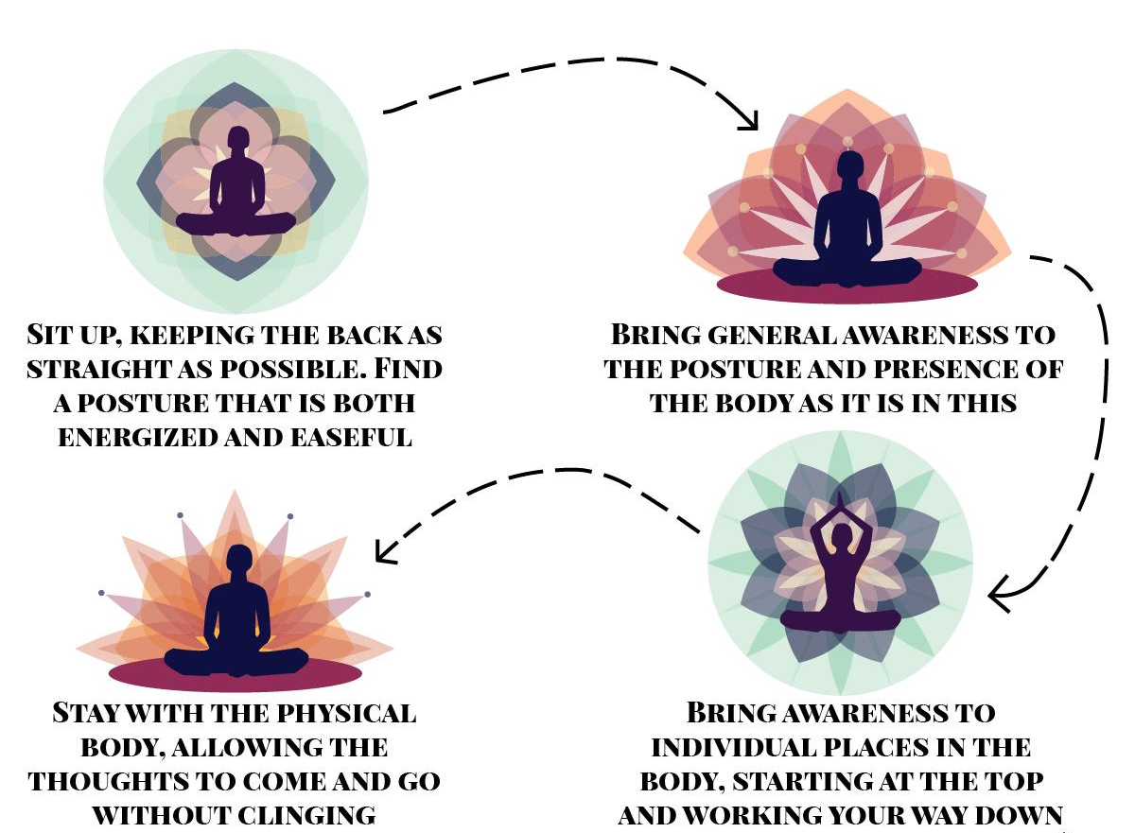
Body Scan
Let’s just notice.
Don’t try to change.
Just notice.
Notes:
** be trauma informed – INVITE THEM to close their eyes. If they do not want to, suggest finding a spot on the floor or in the room looking forward.

Slide 14
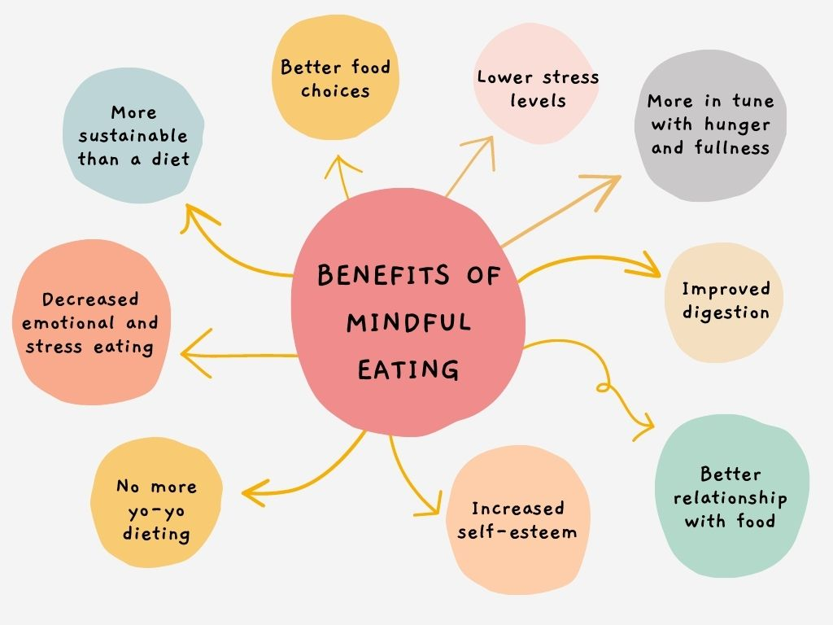
Mindful Eating

Slide 15
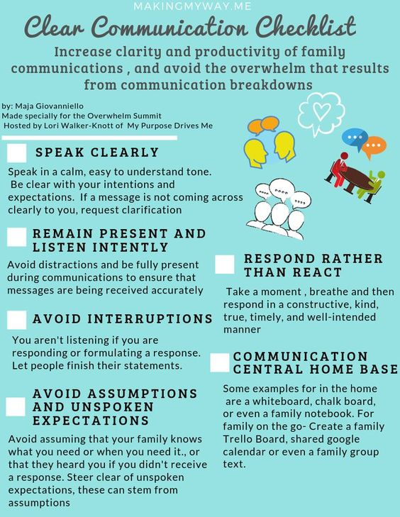
How might I be mindful
in communication?

Slide 16
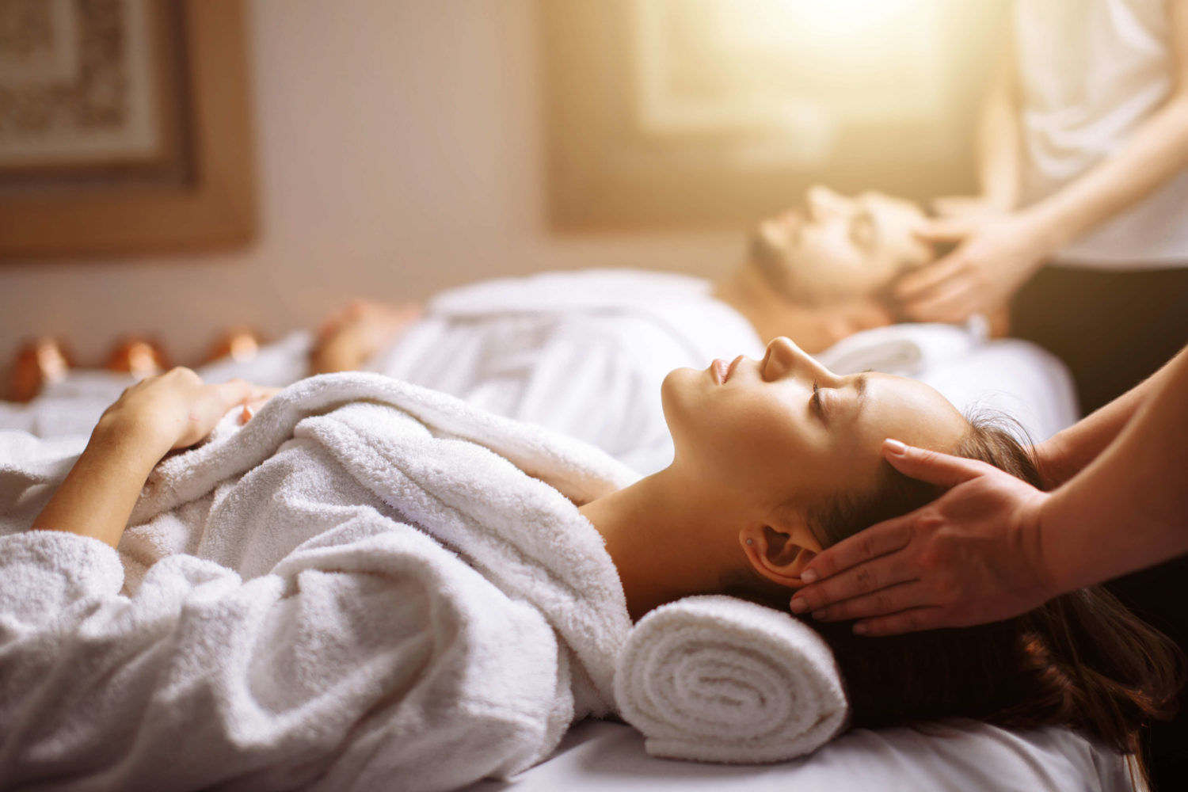
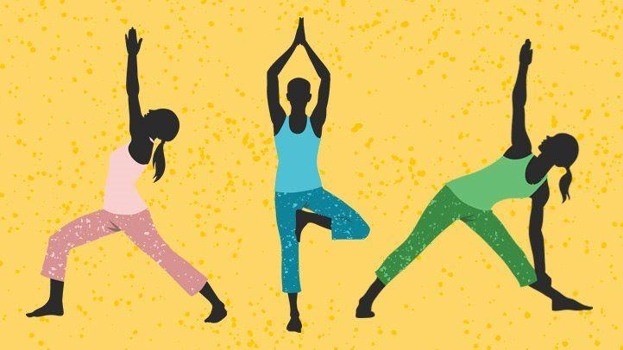
Let’s explore other mindfulness exercises
Guided Imagery Meditation
Massage Therapy
Yoga

Slide 17
Challenges and Overcoming Them
What challenges might we face when trying to practice mindfulness regularly?
Notes:
Problems may be motivation, time, understanding, etc.
Overcoming them with mindfulness buddies, alarms to help us stay on track or a schedule into a daily routine, plan it into our calendar, etc.

Slide 18
Mindfulness resources…
there’s an app for that
#SelfCare Provides an interactive self-care app to practice mindful techniques
Calm Provides meditations, calming music and sleep stories
Plum Village: Zen Meditation
Offers guided meditations, relaxations, and talks
Smiling Mind Daily meditations and mindfulness exercises for teens
Headspace Provides meditations, animations, articles, and videos on mindfulness
Mindfulness Coach App
Offers audio-guided mindfulness exercises, goal-setting assistance, reminders, crisis resources, and more

Slide 19
Okay, let’s
recap
What did you learn?
How can you practice being mindful today?
How might it help you now or in the future?
When can I use mindfulness?
_____________________________

Slide 20
What Questions Do You Have?
Notes:
*don’t forget to remind them that their paper is due Tuesday

Slide 21
